Slide 1
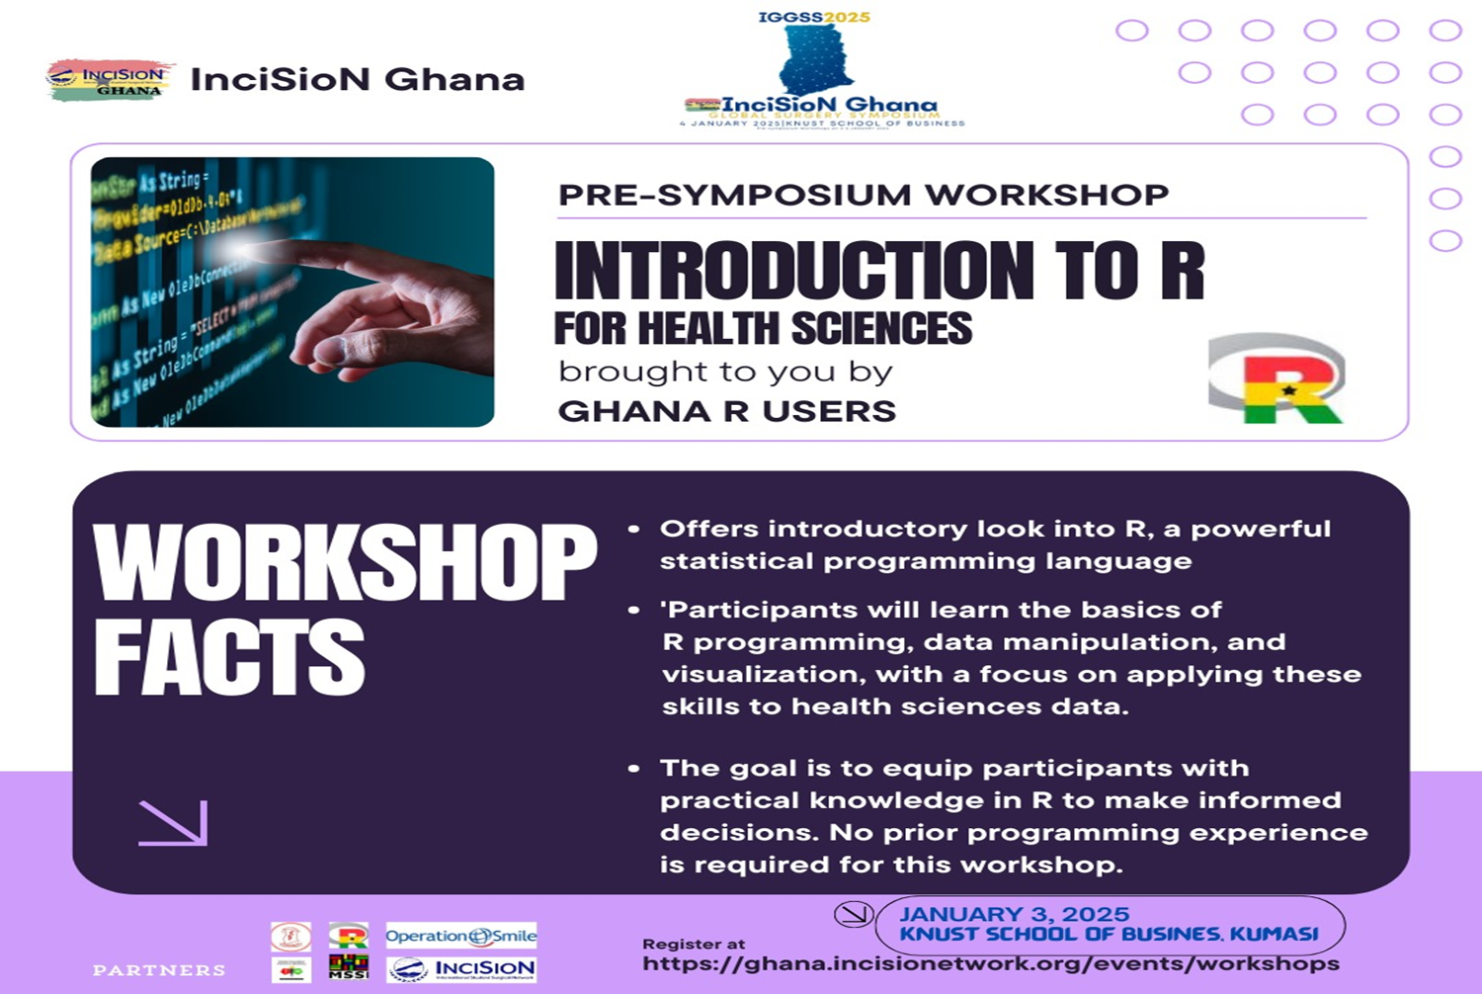

Slide 2



INTRODUCTION TO FOR
HEALTH SCIENCES
Presented By
George Kyei Agyen
(Ghana R User Community)
gkagyen@ghana-rusers.org

Slide 3





Content Outline
Morning Session:
Basics of R & Data Handling
Introduction to R and RStudio
Basic R Programming Concepts
Importing Health Data
[Snack Break : 1 hour]
[Lunch Break : 1 hour]
Afternoon Session:
Data Manipulation and Visualisation
Basic Data Manipulation with dplyr
Data visualisation using ggplot2
Hands-On Practise : mini project
Notes:
Introduction to R
Installing R and Rstudio
Basic RStudio interface
Variables and data types
vectors
basic functions
Importing Health Data
reading csv and excel files
exploring the data
Data manipulation and visualisation
basic data manipulation with dplyr
data visualisation

Slide 4
Morning Session:
Basics of R & Data Handling

Slide 5

Overview of RStudio
R is a programming language and software environment primarily used for statistical computing and graphics. It provides a wide variety of statistical and graphical techniques, making it a powerful tool for data analysis, manipulation, and visualization.
What is
R is open-source, which means it’s freely available for anyone to use and modify, and it has a large and active community of users and developers contributing to its growth and improvement.
Introduction to R and RStudio

Slide 6


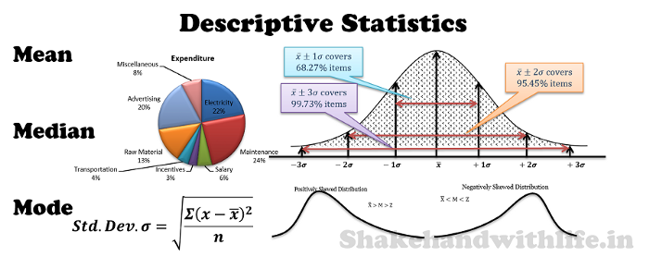
Why R ?
Data Analysis Visualisation
R provides powerful tools for analysing complex health datasets and creating insightful visualisations
Statistical Modelling
The R programming Software is free to use, making it cost effective for healthcare institutions and researchers to handle and analyse large datasets
R has a vast array of packages for various statistical and ML techniques used in healthcare studies
Introduction to R and RStudio

Slide 7



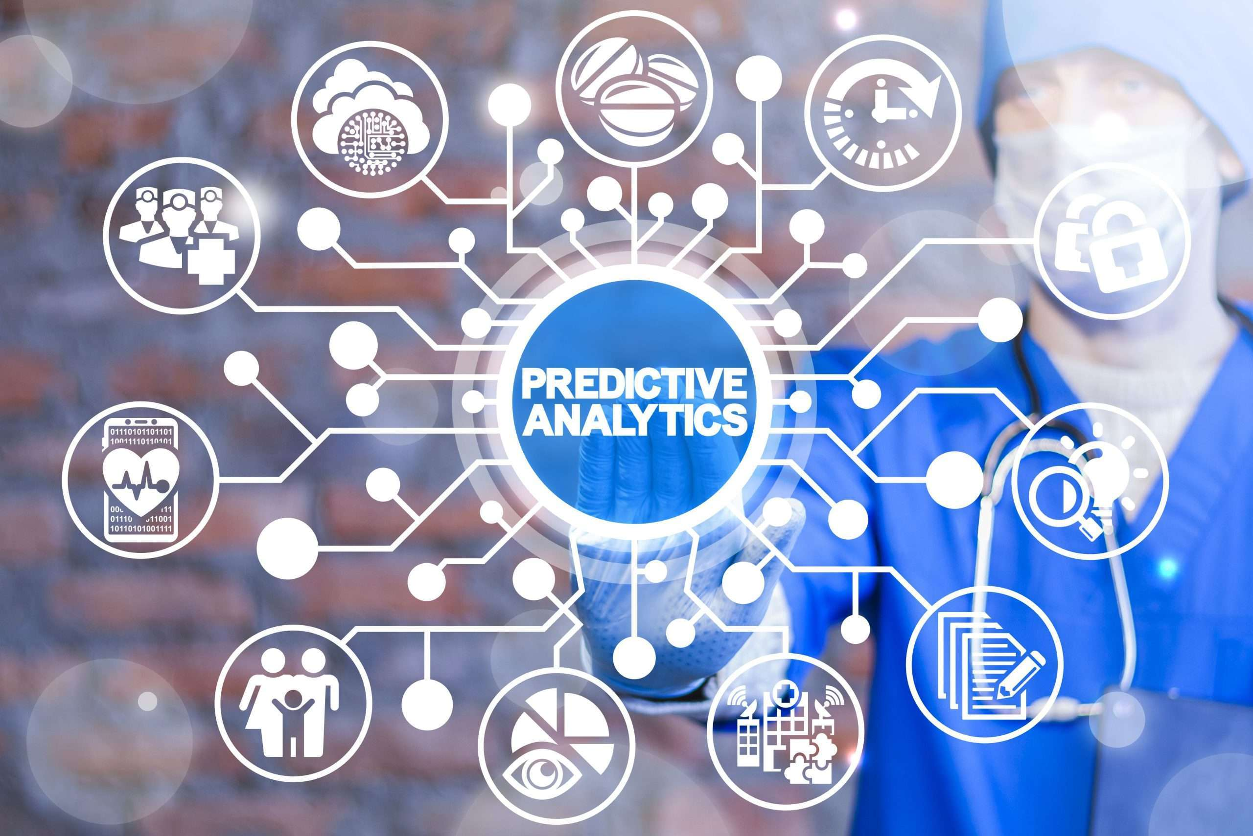
Clinical Trials
Frequently used in the design, analysis and reporting of clinical data. Mostly cleaning, modelling and hypothesis testing
Bioinformatics and Genomics
Widely used for analysing genomic data and bioinformatics applications
Predictive Analytics
Excellent for building predictive models for patient outcomes, treatment effectiveness and risk scoring using ML and statistical methods
Epidemiology Studies
R can model the spread of diseases, track health trends and evaluate intervention strategies
Introduction to R and RStudio
Notes:
R can analyse large scale genomic data helping researchers understand genetic structures, variations and gene functions using packages like (DESeq2, GenABEL, GenomicRanges etc)
In Clinical trials R is commonly used for designing monitoring and analysis. Survival Analysis (survival package) Randomisation and Sample size calculation (powerSurvEpi package)
R is also used for studying the spread, impact and control of diseases like performing descriptive analysis, time series analysis and modelling disease spread.
Predictive analytics is very crucial for predicting patient outcomes, optimizing treatment plans and reducing healthcare costs. We can use ML algorithms to build predictive models for disease diagnosis, or predicting treatment responses.

Slide 8

Overview of RStudio
RStudio is an integrated development environment (IDE) designed specifically for R programming language. RStudio provides a user-friendly interface that makes it easier for users to write code, manage projects, and visualize data.
What is
RStudio significantly enhances the productivity of R users. It is one of the most popular tools among data scientists, statisticians, and researchers due to its powerful features and ease of use
Introduction to R and RStudio

Slide 9
Installing R & RStudio
To start using R and RStudio, you need to:
Install R: Download and install the latest version of R from the Comprehensive R Archive Network (CRAN) website (https://cran.r-project.org/)
Install RStudio: After installing R, download and install RStudio Desktop from the Posit website (https://posit.co/download/rstudio-desktop/)
Launch RStudio: Once installed, open RStudio to start writing and executing R code in the R console or R scripts.
Introduction to R and RStudio

Slide 10
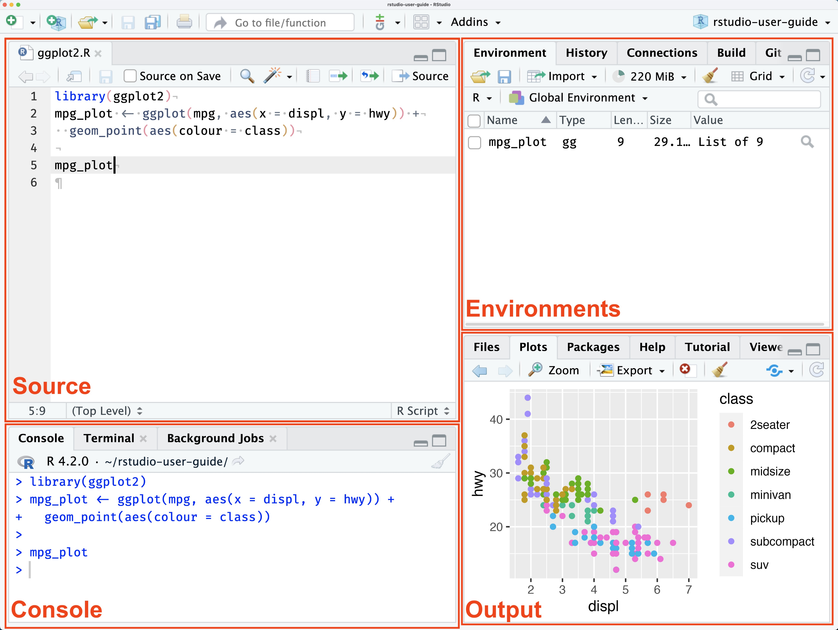
Basic Rstudio Interface
Environment pane
Script Editor
Console
Files and plots pane
Introduction to R and RStudio
Notes:
Console: typing and running R commands
Script: writing and saving scripts
Environment: viewing data, variables and loaded packages
Files and plots pane: navigating files and viewing visualisations

Slide 11
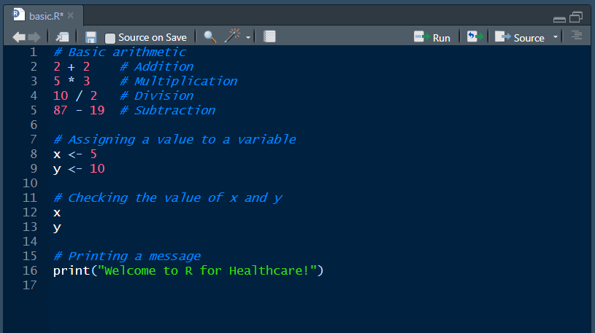
Some Basic Commands
Introduction to R and RStudio

Slide 12




Break:
Take an hour break
Interact
Have a Snack (lunch)
Revise

Slide 13
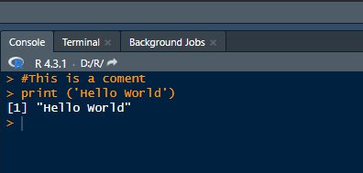
Understanding R Syntax
Case Sensitivity:
R is case-sensitive. For example, variable and Variable are treated as different entities
Comments:
Comments in R are added using #.
Index
Code
Output
Comment
Executing Commands:
R commands are executed line by line.
You can run commands directly in the console or save them in a script file (.R file).
Basic Programming Concept

Slide 14
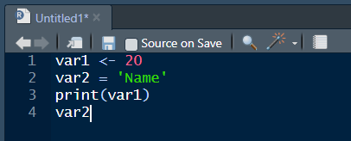
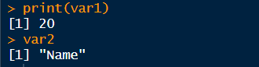
Variables in R
Variables:
Variables store data that can be used and manipulated later.
Variables in R can be created using <- or = operators.
Variable Naming Rules:
Variables can contain letters, numbers, underscores, and dots.
Variables cannot start with a number.
R is case-sensitive, so variable and Variable are different.
Basic Programming Concept

Slide 15
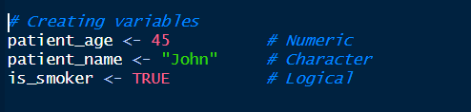
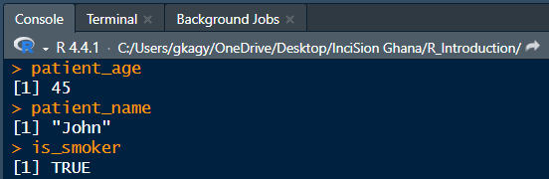
R can handle various data types including:
Numeric data types e.g., 12.5, 100
Character data types e.g., “R is great!”
Logical data types e.g., TRUE FALSE
Basic Programming Concept

Slide 16
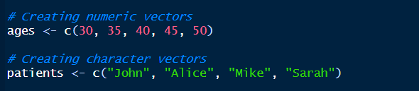
Data Structure: Vectors
R provide several data structures to store and manipulate data. Vectors are one of the commonly used data structures in R. Others types include Vectors, Matrices, Lists, Tibbles, dataframes etc.
A vector is a sequence of data elements of the same type. It’s one of the most basic data structures in R.
Vectors are created using the c() function, which stands for "combine" or "concatenate."
Basic Programming Concept

Slide 17
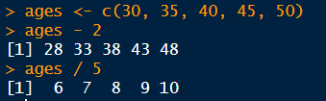
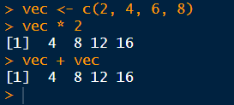
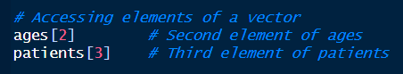
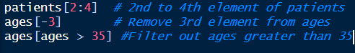
We can perform arithmetic operations on vectors. The operations are applied element-wise
We can also extract individual elements from a vector using [] (square brackets)
Basic Programming Concept

Slide 18
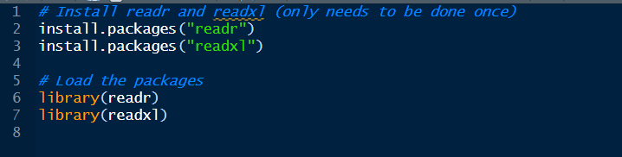
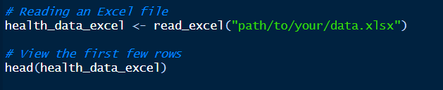
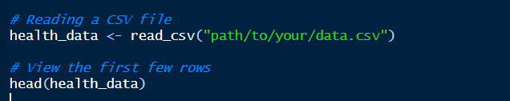
Importing Data
More often data in health research are stored in a csv or excel format. R provides packages like readr and readxl to read these files into the R environment
Install and Load Packages
Import Excel File
Import CSV File
Reading csv and excel files

Slide 19
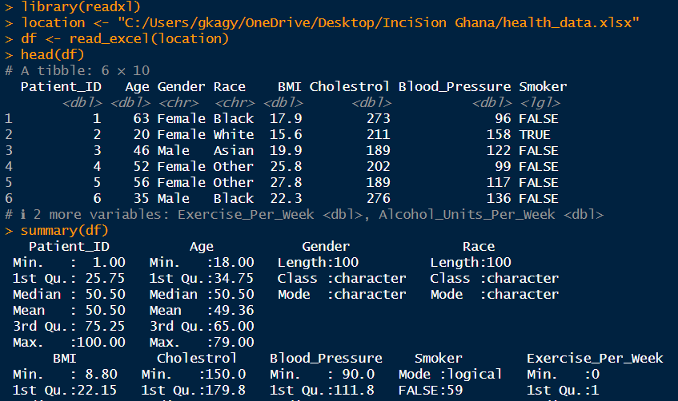
Once the data is loaded. We can explore the data using some built in functions like head(), str(), summarise(), tail() and others
Reading csv and excel files

Slide 20
Afternoon Session:
Basic Data Manipulation and Visualisation

Slide 21
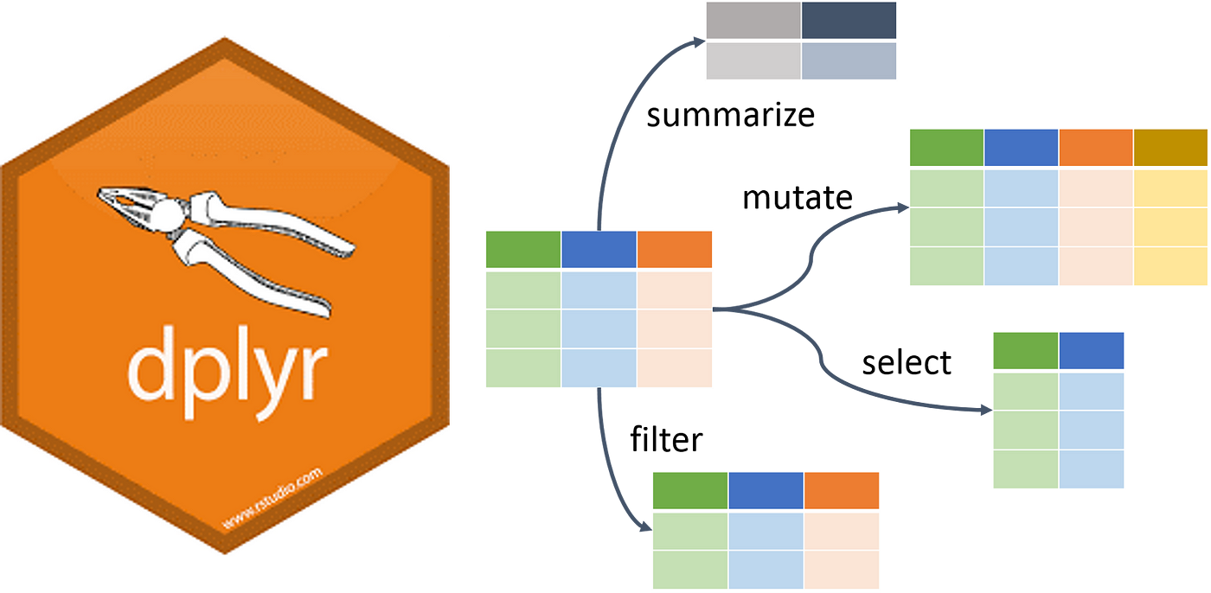
Basic Data Manipulation with dplyr
The dplyr package makes data manipulation in R easy and readable. It allows users to filter, arrange, select, mutate, and summarize data efficiently
Some Key Functions in dplyr
filter() : Subset rows on a condition
select() : Select specific columns
mutate() : Adds, modifies variables/ columns
arrange() : Reorder rows
summarise() : Reduces multiple values down to a summary
group_by() : Groups data for performing operations on subgroups
Data Manipulation and Visualisation

Slide 22



Practise data manipulation in RStudio
TO DO
Install and load dplyr package
filter patients over the age of 40 who are smokers
select only the patient_id, age and bmi columns
create a new column (overweight), indicating if a patient is overweight (bmi > 25)
Arrange the data by cholestrol level in descending order
Summarise the average cholesterol level in the dataset
Group by gender and summarise the average bmi for each gender
Data Manipulation and Visualisation

Slide 23
Break:
Take an hour break
Interact
Have a Snack (lunch)
Revise

Slide 24
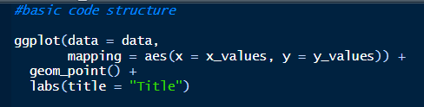
Data Visualisation using ggplot2
ggplot2 is a powerful visualization package in R that allows users to create informative and aesthetically pleasing plots. It follows a layered approach to building plots.
main function to initiate plot canvas
Addition symbol to add new layer
Data: The dataset you want to visualize.
Aesthetics (aes()): Maps data variables to visual properties (e.g., x-axis, y-axis, color)
.
Geometries (geom_*()): Specifies the type of plot (e.g., points, lines, bar plot)
Another layer for adding plot title
Geometries (geom) layer to determine type of plot

Slide 25
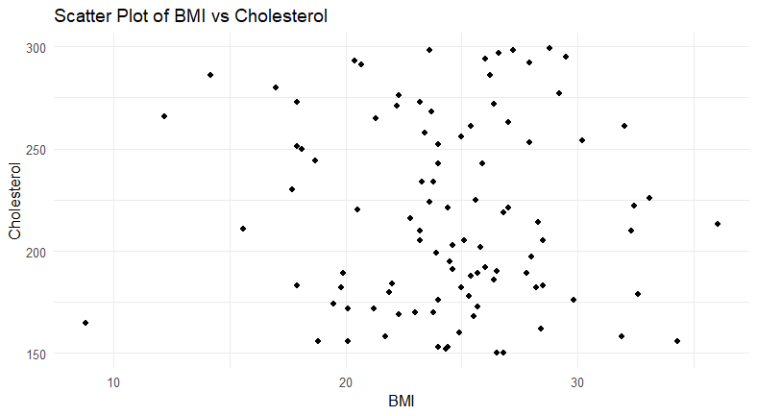
Scatter plot example using ggplot2

Slide 26
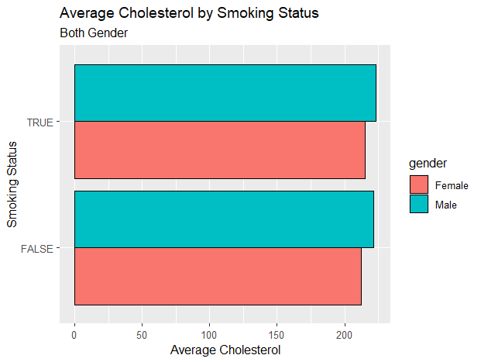
Bar plot example using ggplot2

Slide 27
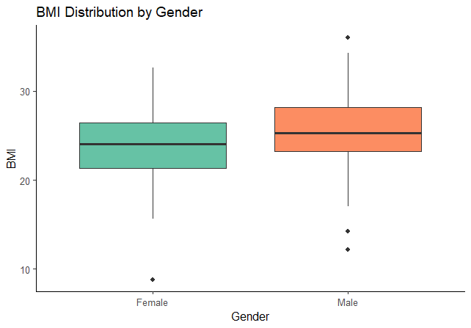
Box plot example using ggplot2

Slide 28
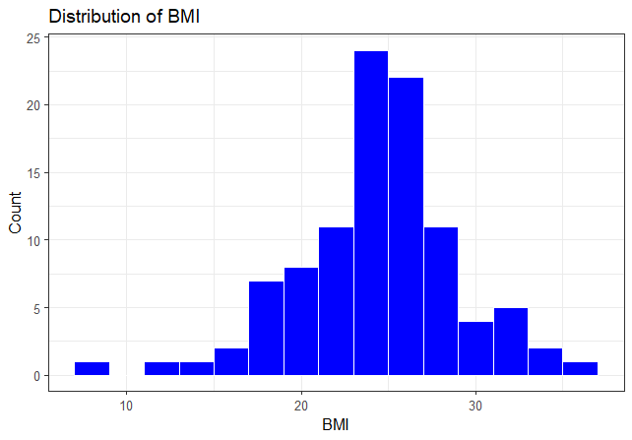
Histogram plot example using ggplot2

Slide 29
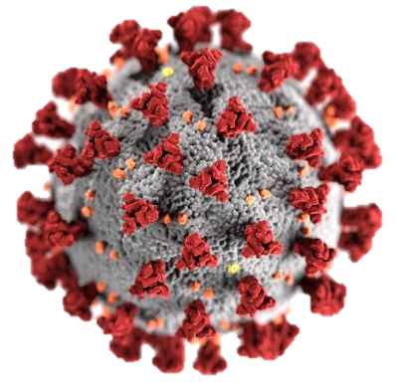
Mini - Project:
Analysing Covid-19 Testing Data

Slide 30


Analyzing COVID-19 Testing Data
Objective: The goal of this mini project is to perform basic data manipulation and visualisation on the covid_testing dataset found in the medicaldata package. This is to allow learners explore trends and insights related to covid 19 testing and also have a hands on practice to appreciate the application of R

Slide 31
Steps for Mini Project
Import the data:
We use the covid_testing dataset from the medicaldata package
Explore the data:
Use functions like head(), summary() and str() to understand the structure of the data
Identify some key variables from the data
Clean the data:
Check data for missing values or any information that does not make sense
Handle missing data if any

Slide 32
Manipulating data with dplyr:
Filter the data to focus on specific groups
Perform some summarisations (e.g. average cycle threshold for positive cases)
Group the data and also create new columns out of existing columns
Data Visualisation:
Make a bar plot to visualise categorical data
Make a box plot to visualise both categorical and numerical data
Make a line plot or scatter plot to visualise numeric data
Summarise key findings based on analysis
- Create a report with Quarto (bonus)✨

